Slide 1
PRODUCT METRICS

Slide 2
Software Quality
Software quality is
- conformance to explicitly stated functional and performance requirements,
- explicitly documented development standard, and
- implicit characteristics that are expected of all professionally developed software.
Software quality is complex mix of factors that will vary across different applications and the customers who request them.

Slide 3
McCall’s Triangle of Quality
M
a
i
n
t
a
i
n
a
b
i
l
i
t
y
M
a
i
n
t
a
i
n
a
b
i
l
i
t
y
P
o
r
t
a
b
i
l
i
t
y
P
o
r
t
a
b
i
l
i
t
y
F
l
e
x
i
b
i
l
i
t
y
F
l
e
x
i
b
i
l
i
t
y
R
e
u
s
a
b
i
l
i
t
y
R
e
u
s
a
b
i
l
i
t
y
T
e
s
t
a
b
i
l
i
t
y
T
e
s
t
a
b
i
l
i
t
y
I
n
t
e
r
o
p
e
r
a
b
i
l
i
t
y
I
n
t
e
r
o
p
e
r
a
b
i
l
i
t
y
P
R
O
D
U
C
T
R
E
V
I
S
I
O
N
P
R
O
D
U
C
T
R
E
V
I
S
I
O
N
P
R
O
D
U
C
T
T
R
A
N
S
I
T
I
O
N
P
R
O
D
U
C
T
T
R
A
N
S
I
T
I
O
N
P
R
O
D
U
C
T
O
P
E
R
A
T
I
O
N
P
R
O
D
U
C
T
O
P
E
R
A
T
I
O
N
C
o
r
r
e
c
t
n
e
s
s
C
o
r
r
e
c
t
n
e
s
s
U
s
a
b
i
l
i
t
y
U
s
a
b
i
l
i
t
y
E
f
f
i
c
i
e
n
c
y
E
f
f
i
c
i
e
n
c
y
I
n
t
e
g
r
i
t
y
R
e
l
i
a
b
i
l
i
t
y
I
n
t
e
g
r
i
t
y
R
e
l
i
a
b
i
l
i
t
y

Slide 4
A Comment
McCall’s quality factors were proposed in the early 1970s. They are as valid today as they were in that time. It’s likely that software built to conform to these factors will exhibit high quality well into the 21st century, even if there are dramatic changes in technology.

Slide 5
Measures, Metrics and Indicators
A measure provides a quantitative indication of the extent, amount, dimension, capacity, or size of some attribute of a product or process
The IEEE glossary defines a metric as “a quantitative measure of the degree to which a system, component, or process possesses a given attribute.”
An indicator is a metric or combination of metrics that provide insight into the software process, a software project, or the product itself

Slide 6
Measurement Principles
The objectives of measurement should be established before data collection begins;
Each technical metric should be defined in an unambiguous manner;
Metrics should be derived based on a theory that is valid for the domain of application (e.g., metrics for design should draw upon basic design concepts and principles and attempt to provide an indication of the presence of an attribute that is deemed desirable);
Metrics should be tailored to best accommodate specific products and processes [Bas84]

Slide 7
Measurement Process
Formulation. The derivation of software measures and metrics appropriate for the representation of the software that is being considered.
Collection. The mechanism used to accumulate data required to derive the formulated metrics.
Analysis. The computation of metrics and the application of mathematical tools.
Interpretation. The evaluation of metrics results in an effort to gain insight into the quality of the representation.
Feedback. Recommendations derived from the interpretation of product metrics transmitted to the software team.

Slide 8
Goal-Oriented Software Measurement
The Goal/Question/Metric Paradigm
  (1) establish an explicit measurement goal that is specific to the process activity or product characteristic that is to be assessed
  (2) define a set of questions that must be answered in order to achieve the goal, and
  (3) identify well-formulated metrics that help to answer these questions.
Goal definition template
  Analyze {the name of activity or attribute to be measured}
  for the purpose of {the overall objective of the analysis}
  with respect to {the aspect of the activity or attribute that is considered}
  from the viewpoint of {the people who have an interest in the measurement}
  in the context of {the environment in which the measurement takes place}.

Slide 9
Metrics Attributes
Simple and computable. It should be relatively easy to learn how to derive the metric, and its computation should not demand inordinate effort or time
Empirically and intuitively persuasive. The metric should satisfy the engineer’s intuitive notions about the product attribute under consideration
Consistent and objective. The metric should always yield results that are unambiguous.
Consistent in its use of units and dimensions. The mathematical computation of the metric should use measures that do not lead to bizarre combinations of unit.
Programming language independent. Metrics should be based on the analysis model, the design model, or the structure of the program itself.
Effective mechanism for quality feedback. That is, the metric should provide a software engineer with information that can lead to a higher quality end product

Slide 10
Collection and Analysis Principles
Whenever possible, data collection and analysis should be automated;
Valid statistical techniques should be applied to establish relationship between internal product attributes and external quality characteristics
Interpretative guidelines and recommendations should be established for each metric

Slide 11
Function-Based Metrics
The function point metric (FP), first proposed by Albrecht [ALB79], can be used effectively as a means for measuring the functionality delivered by a system.
FP can be used to (a) estimate the cost or effort required to design, code, and test the software; (b) predict the number of errors that will be encountered during testing, and (c) forecast the number of components and / or the number of projected source lines in the implemented systems.
Function points are derived using an empirical relationship based on countable (direct) measures of software's information domain and assessments of software complexity
Information domain values are defined in the following manner:
  number of external inputs (EIs)
  number of external outputs (EOs)
  number of external inquiries (EQs)
  number of internal logical files (ILFs)
  Number of external interface files (EIFs)

Slide 12
Function-Based Metrics
Information Domain Values
  Number of external inputs (EIs): Each external input originates from a user or is transmitted from another application and provides distinct application-oriented data or control information. Inputs are often used to update internal logical files (ILFs). Inputs should be distinguished from inquiries, which are counted separately.
  Number of external outputs (EOs): Each external output is derived data within the application that provides information to the user. In this context external output refers to reports, screens, error messages, etc. Individual data items within a report are not counted separately.
  Number of external inquiries (EQs): An external inquiry is defined as an online input that results in the generation of some immediate software response in the form of an online output (often retrieved from an ILF).
  Number of internal logical files (ILFs): Each internal logical file is a logical grouping of data that resides within the application’s boundary and is maintained via external inputs.
  Number of external interface files (EIFs): Each external interface file is a logical grouping of data that resides external to the application but provides information that may be of use to the application.

Slide 13

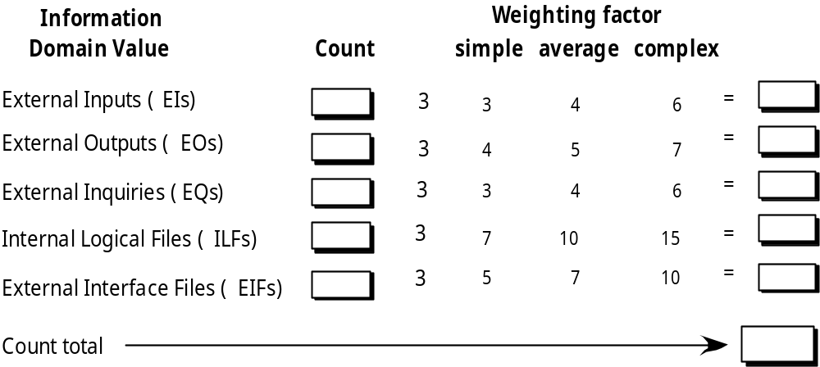
Function Points

Slide 14
Function Point
Please go through the Chapter 23, page number 620 – 623 to read the details of FP

Slide 15
Function Point
Exercise:
A system has 12 external inputs, 24 external outputs, fields 30 different external queries, manages 4 internal logical files, and interfaces with 6 different legacy systems (6 EIFs). All of these data are of average complexity and the overall system is relatively simple. Compute FP for the system.
Assume: average weighted factor = (simple) 4 and the sum of Value Adjustment Factors (VAF) = (average complexity) 45

Slide 16
Maintenance Metrics
IEEE Std. 982.1-1988 suggests a software maturity index (SMI) that provides an indication of the stability of a software product (based on changes that occur for each release of the product). The following information is determined:
    M_{T} = the number of modules in the current release
    F_{c} = the number of modules in the current release that have been changed
    F_{a} = the number of modules in the current release that have been added
    F_{d} = the number of modules from the preceding release that were deleted in the current release
The software maturity index is computed in the following manner:
    SMI = [M_{T} - (F_{a} + F_{c} + F_{d})]/M_{T}
As SMI approaches 1.0, the product begins to stabilize.
SMI can also be used as a metric for planning software maintenance activities.

Slide 17
Maintenance Metrics
Exercise:
A legacy system has 940 modules. The latest release required that 90 of these modules be changed. In addition, 40 new modules were added and 12 old modules were removed. Compute the software maturity index for the system.

